Slide 1
Street Smarts Marin
Marin City Community Services District Board Meeting
February 8, 2023

Slide 2
What Is Street Smarts?
Traffic safety program run by TAM
Educates drivers, pedestrians, and bicyclists about safety issues in order to encourage positive behavior change
Designed to make Marin’s streets safer and friendlier and to reduce the number of traffic-related collisions

Slide 3
New Opportunities for Fall 2022 Rollout
Banners and signs are worn out and dated
New data is available on where collision hot spots are located…
…and what types of collisions are prevalent
Social media help spread the word
Notes:
Campaign has been going on for several years – fall 2022 was time for a refresh

Slide 4
Moving Forward with Street Smarts
Data-driven focus
Targeted messaging
Updated branding
New media platforms
Notes:
New media platforms = Facebook, Instagram, etc.

Slide 5
2016-2020 Collisions
Total: 14,159

Slide 6
Vulnerable User Collisions
433 Pedestrian Collisions
(3% of total)
724 Bicycle Collisions
(5% of total)

Slide 7
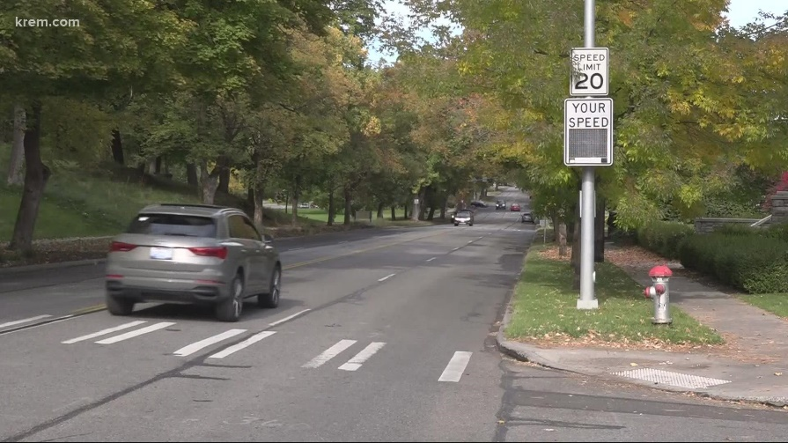
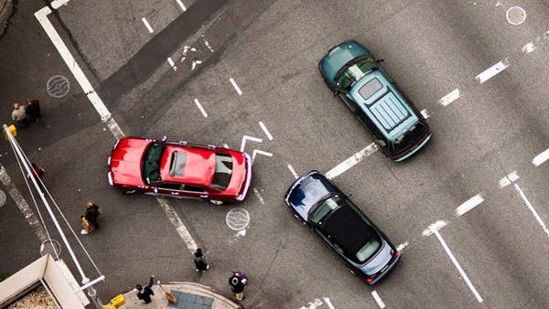
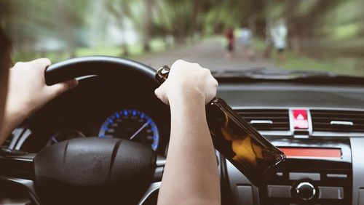
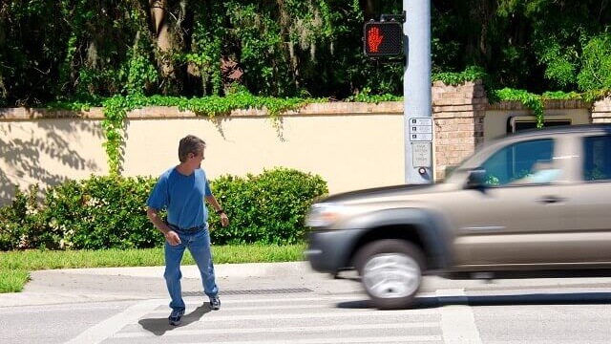
Top Primary Collision Factors
*ROW = right-of-way
Notes:
The top PCFs are consistent when looking at all crashes, KSI crashes, and fatal crashes
Drunk driving was deemed to be too big a topic to cover just as part of this program

Slide 8
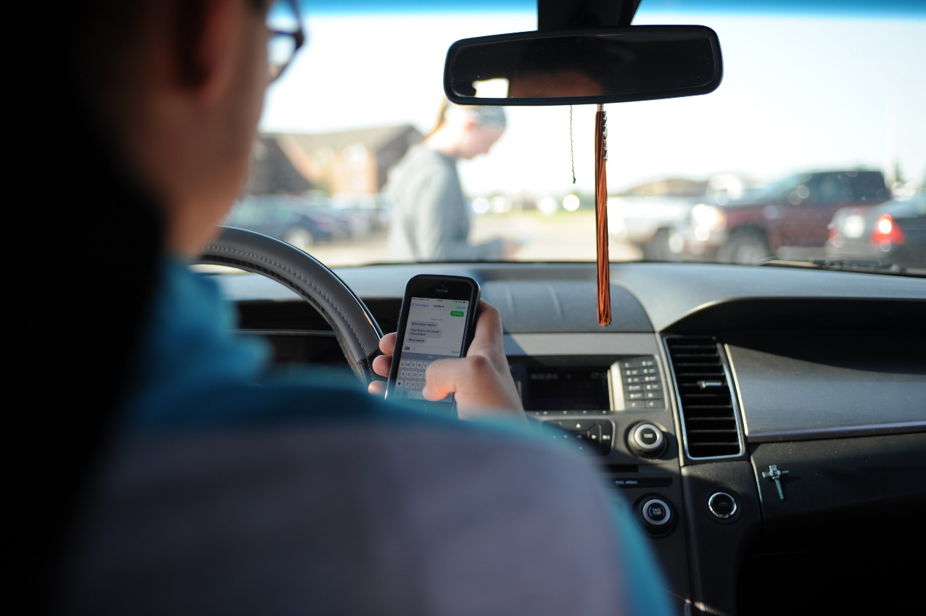
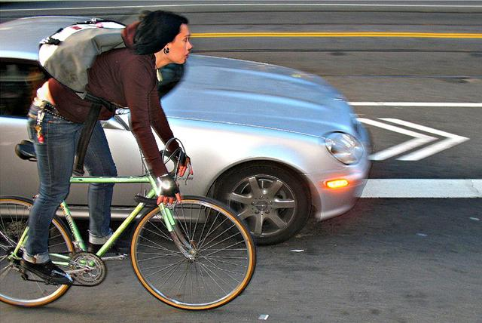
Other Important Trends
Distracted Driving
More than 54% percent of California drivers surveyed said they had been hit or nearly hit by a driver who was talking or texting on a cell phone
Bicycles at Fault (3% of all crashes)
Top primary collision factors (PCFs) are largely the same as vehicle-at-fault collisions
Other PCFs: wrong side of road, traffic signals and signs
Notes:
Distracted driving not recorded in Marin County data, but statewide surveys show that this is an important issue
While the percentage of bicycles at fault is low, unsafe behavior should still be addressed

Slide 9
Target Behaviors
Six target behaviors selected based on 2016-2020 Marin County collision data:
Making Safe Turns
Speeding
Distracted Driving
Looking for Pedestrians in the Crosswalk
Safe Walking
Following the Rules of the Road

Slide 10
Task Force
Convened task force with 17 members representing cities, law enforcement, and schools to refresh campaign messaging and design
CHP
City of Novato
City of San Rafael
County of Marin
Kentfield School Board
Marin City
Marin County Dept. of Public Works
Novato School District
Parisi Transportation Consulting
Safe Routes to Schools
TAM
Town of San Anselmo
West Marin
Notes:
Reviewed successful education campaigns across the country
Utilized proven strategies for effective messaging
Opted for eye-catching designs simple enough to not be too distracting
Sought input from MCBC on messaging

Slide 11
Updated Banner & Lawn Sign Designs
Vertical banners
Yard signs
Notes:
Banners will be hung from light posts around the county
Yard signs will be available for pick-up at public works departments

Slide 12
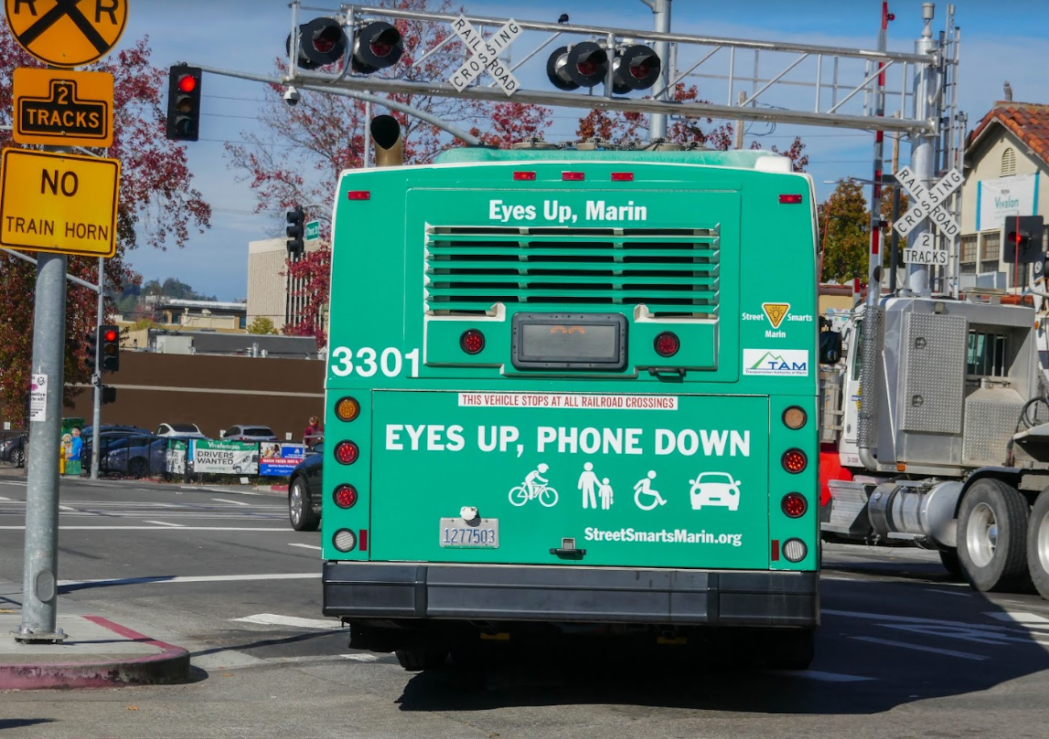
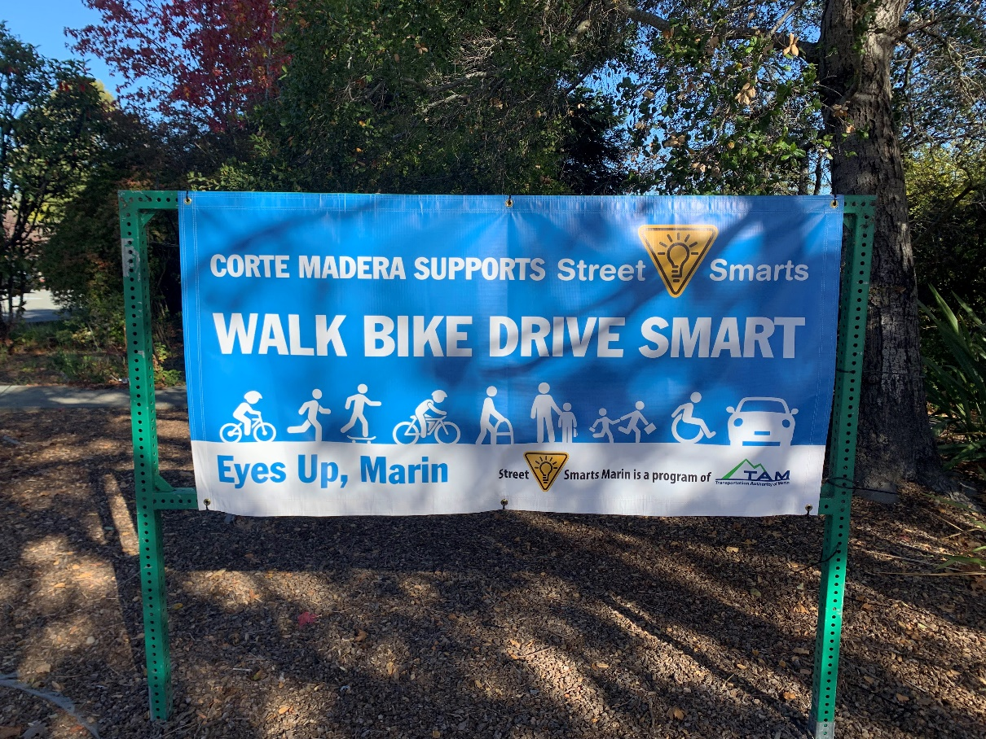
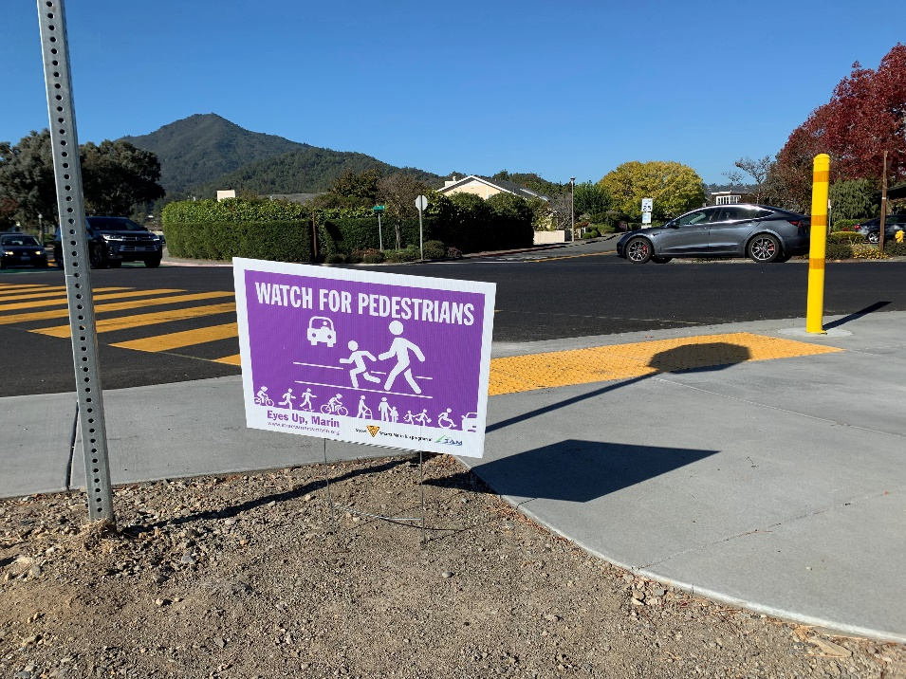
Street Smarts Deployment – Fall 2022
Notes:
Almost 150 banners deployed in all jurisdictions and unincorporated Marin County
Signs hung at Bayside MLK campuses

Slide 13
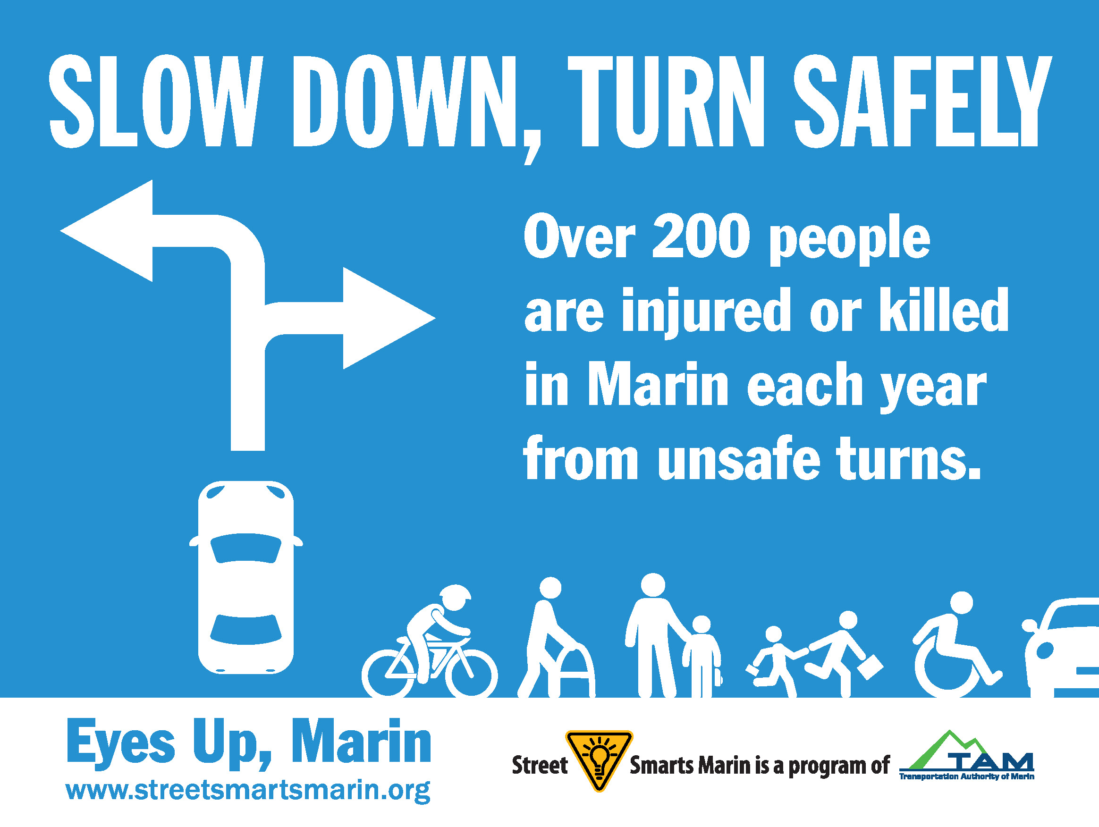
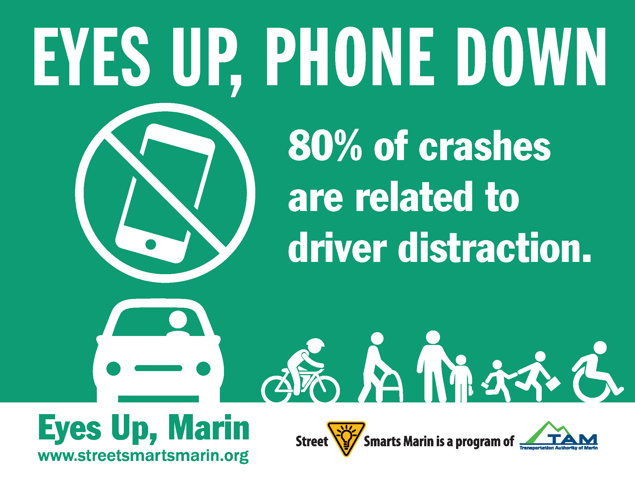
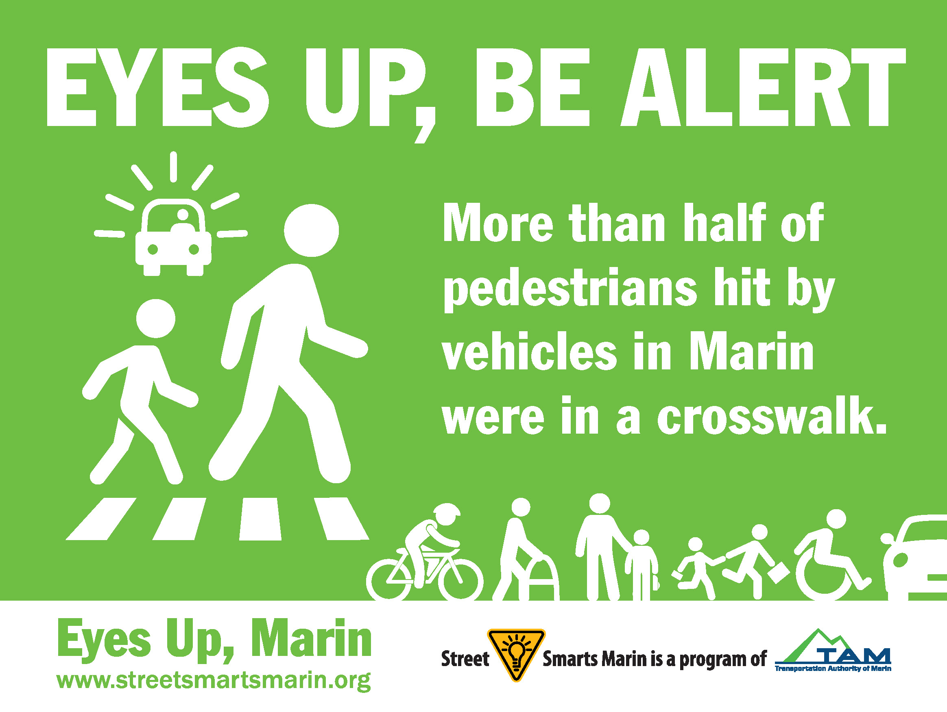
Social Media Designs
Social media designs (also available in Spanish)

Slide 14
Social Media Designs
Email signatures
Social media graphic (available in Spanish)

Slide 15
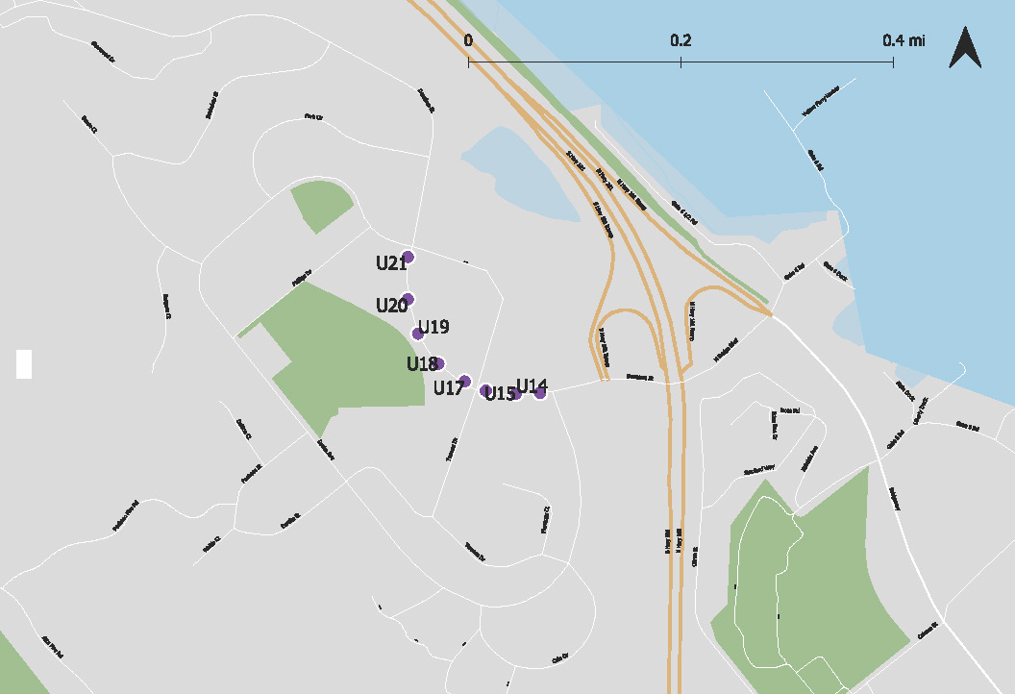
Marin City Banner Proposed Locations
ID | Proposed Message | Location
U14 | Eyes up, phone down | Donahue
U15 | Follow the rules of the road | Donahue
U16 | Slow down, turn safely | Donahue
U17 | Watch for pedestrians | Donahue
U18 | Eyes up, be alert | Donahue
U19 | Watch for pedestrians | Donahue
U20 | Eyes up, phone down | Donahue
U21 | Eyes up, be alert | Donahue
Notes:
8 banners initially planned for Drake based on a collision trends analysis
Despite getting County approvals, we were unable to hang the banners last fall due to the presence of other banners
Reached out to Juanita at the Marin City CDC to introduce the program
From the County, the previous banners are being renewed for this year

Slide 16
How to Get Involved
Campaign rollout April 10 – May 31
Display street light banners
Display yard signs
Share social media packages
Use email signatures
Materials will be available for download at:
https://www.streetsmartsmarin.org/

Slide 17
Questions?
Thank you!
Jen Shriber
Parisi Transportation Consulting
jennifer@parisi-associates.com
510-343-6963

